Slide 1

Suburban Futures
Melbourne Data Analytics Platform
Internship Final Presentation
2026

Slide 2



My Internship Journey
Explored
Built
Discovered
Dived into open government datasets –
ABS Census, DHHS bond data, GTFS transport feeds — and learned to clean, join and interpret large real-world data.
Created four interactive maps covering public transport, ethnicity, migration and rental affordability across Greater Melbourne.
Found that data tells vivid human stories where communities settle, how rents surge outward, how a pandemic reshapes a city overnight.

Slide 3




Four Maps — One City
Transit Accessibility- Heat Map
Suburb Ethnicity Map
Most-used train stations
ABS Census 2021 · 10+ ancestry layers
Data Vic
ABS Census Data packs for 2021
Migration Over Time Map
Melbourne Rental Analysis
2011 · 2016 · 2021 Census comparison
2000–2025 · 31 LGAs · 4 visualisations
ABS 2021 Time Series Profile
Deep Dive

Slide 4
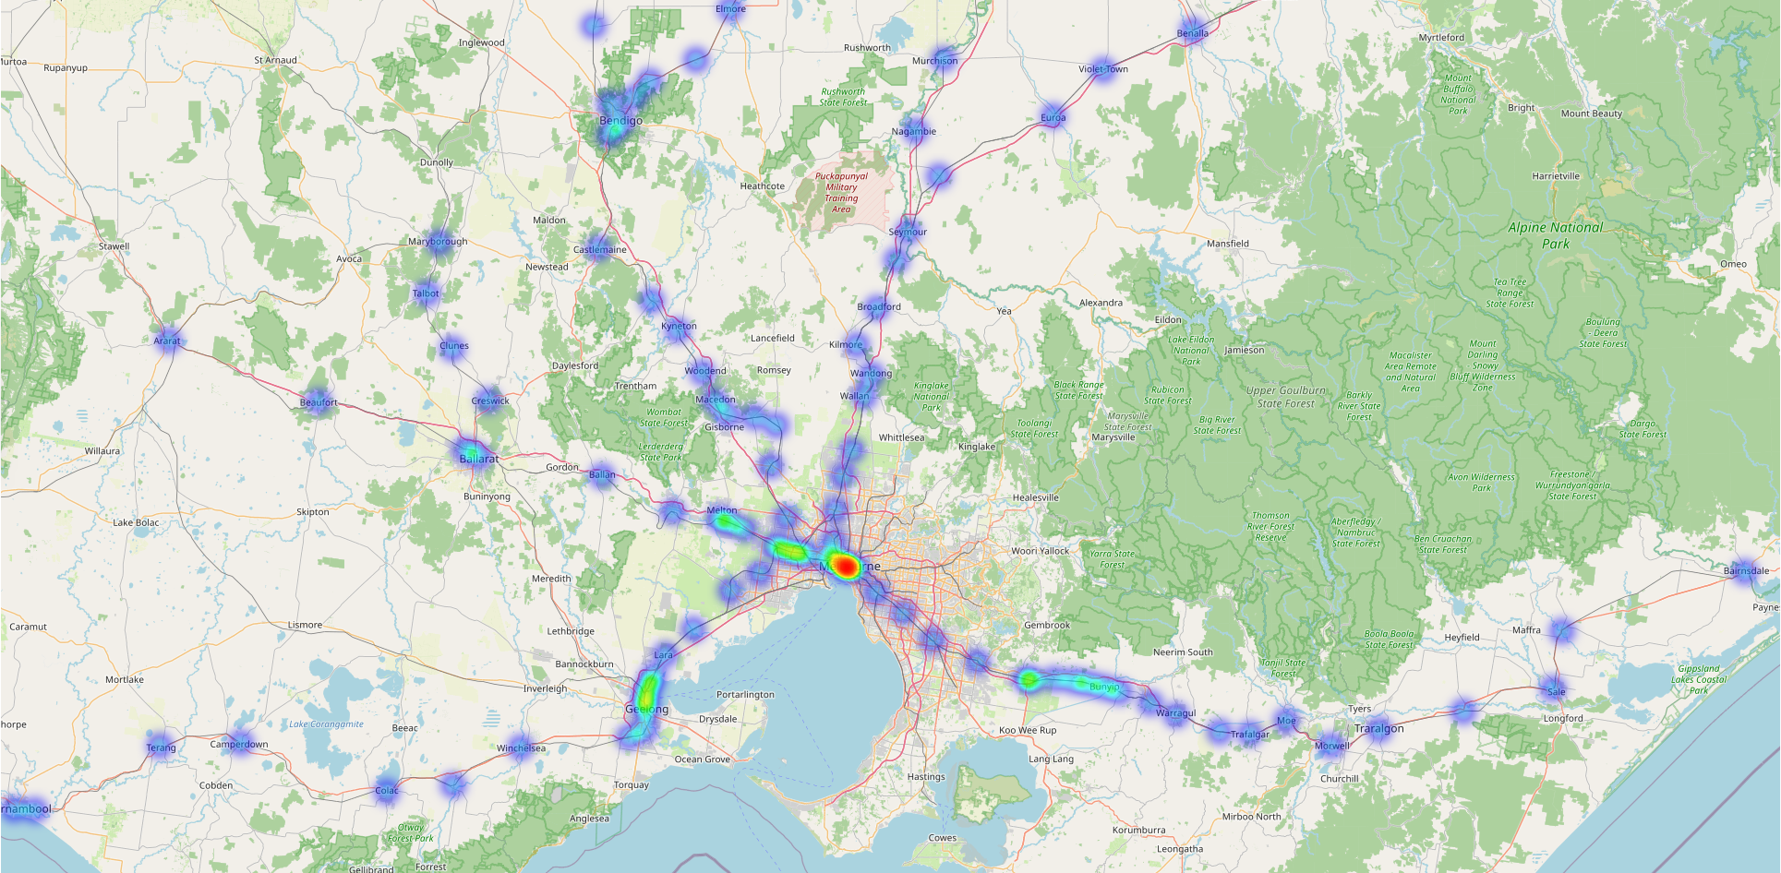
Transit Accessibility- Heat Map

Slide 5
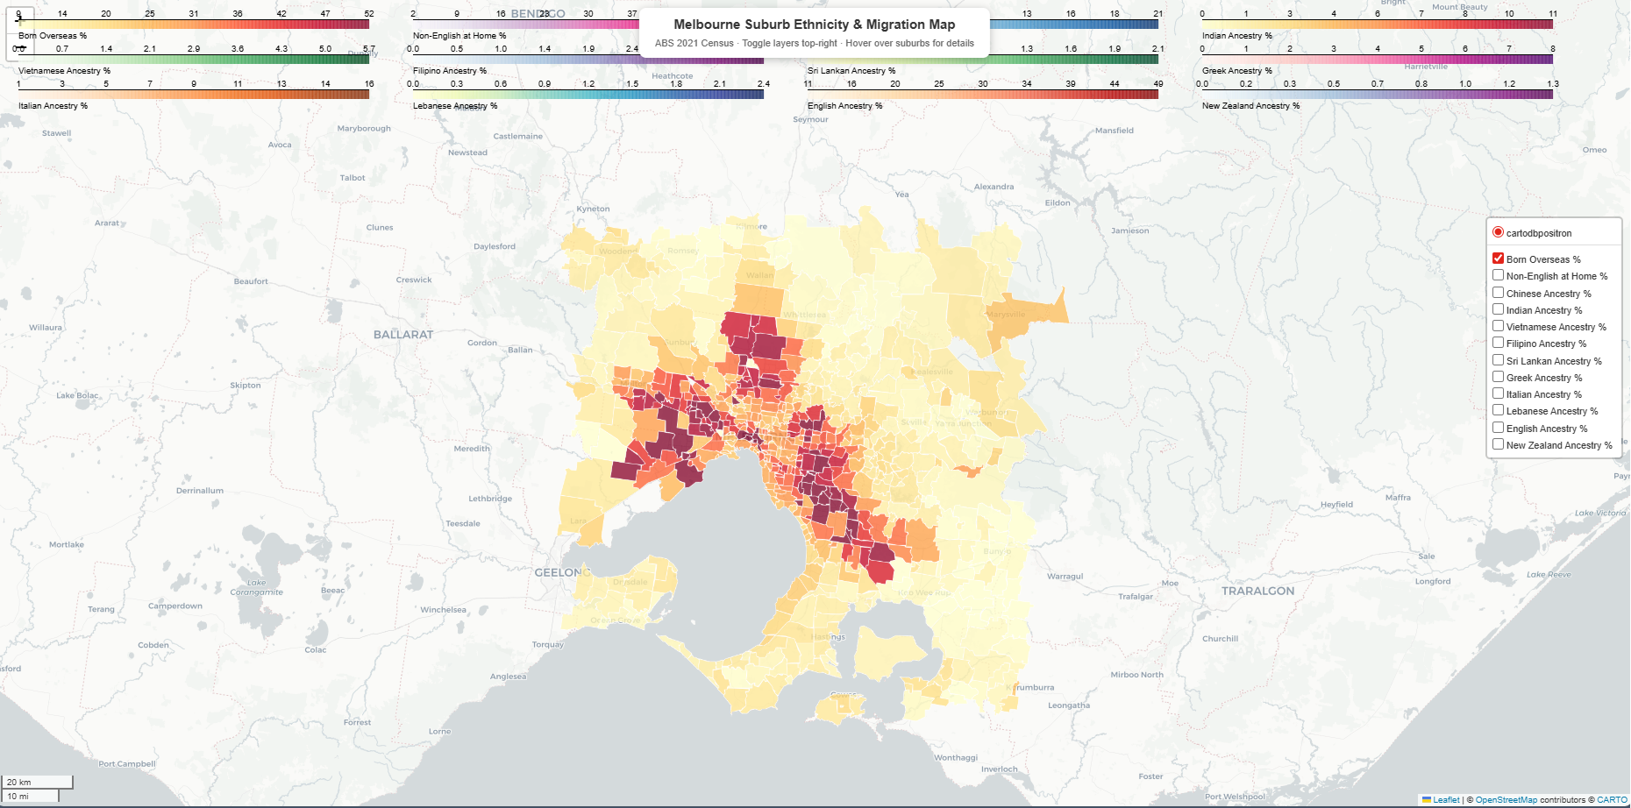
Suburbs Ethnicity Map- melbourne_ethnicity_map(1) (1).html

Slide 6
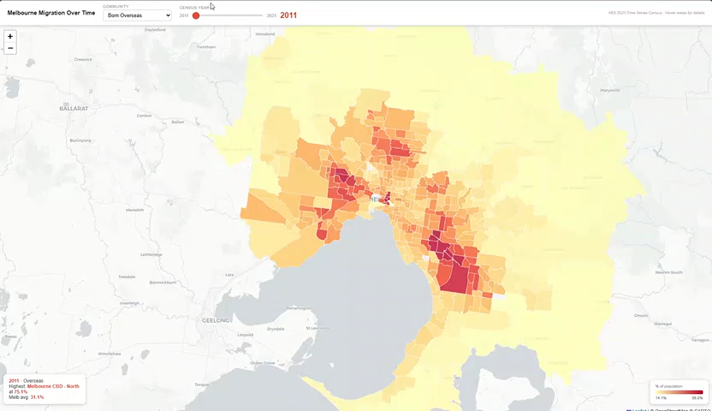
Migration Over Time Map- Melbourne Migration Over Time

Slide 7
Melbourne Rental Analysis
Victoria’s Residential Tenancies Bond Authority Data, DHHS/Data Vic
31
25+
7
3
Melbourne Metro LGAs
Years of Data (2000–2025)
Property Types
Metro Regions
North & West Metro
Eastern Metro
Southern Metro

Slide 8
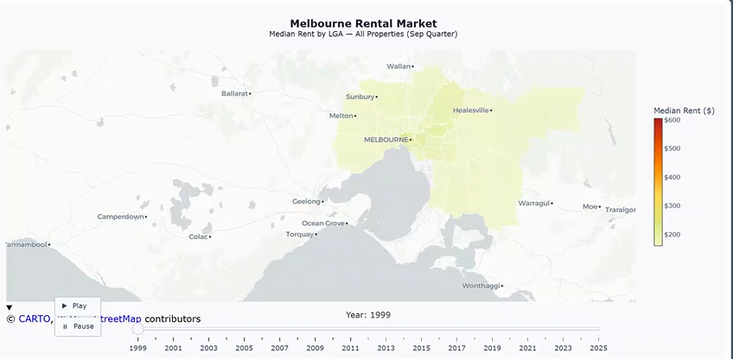
Melbourne Rental Market- melbourne_rental_market.html

Slide 9
Melbourne Rental Market
What it shows
Key Findings
Inner east (Stonnington, Boroondara, Bayside) has been the most expensive throughout the entire 25-year period.
Time-slider choropleth showing median rent per LGA for every September quarter from 2000 to 2025.
Colour uses quantile classification so differences across LGAs remain visible even when the rent range is wide.
Hover tooltip shows: LGA rent · Melbourne median · deviation from average · year-on-year change.
1
Outer west & north (Melton, Wyndham, Hume) remain most affordable — but have been rapidly catching up.
2
The colour gradient has intensified and spread outward over time — rental pressure is no longer confined to the inner ring.
3

Slide 10
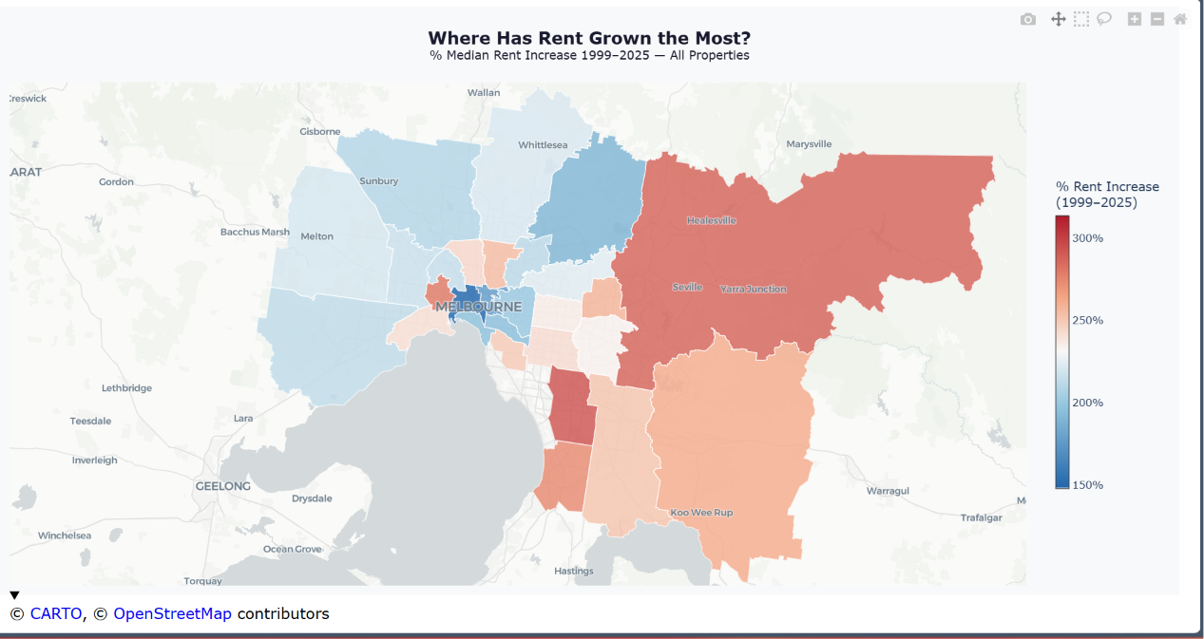
Affordability Pressure Map- melbourne_rent_change_map.html

Slide 11
Affordability Pressure Map
% Rent Growth Per LGA Since 2000 — separating 'always expensive' from 'rapidly becoming expensive'
Outer Growth Corridors
Inner Established Suburbs
Melton · Wyndham · Casey · Cardinia
Stonnington · Boroondara · Bayside
Highest percentage rent growth of any LGAs. These were affordability refuges in 2000 — they are no longer comparatively affordable. Population expansion into greenfield estates drove rapid demand.
Most expensive in absolute terms throughout the period, but relatively lower % growth. They hit the ceiling early — there was less headroom for further increases.
Tooltip highlight: Post-COVID column isolates the 2019–2025 surge specifically for each LGA

Slide 12
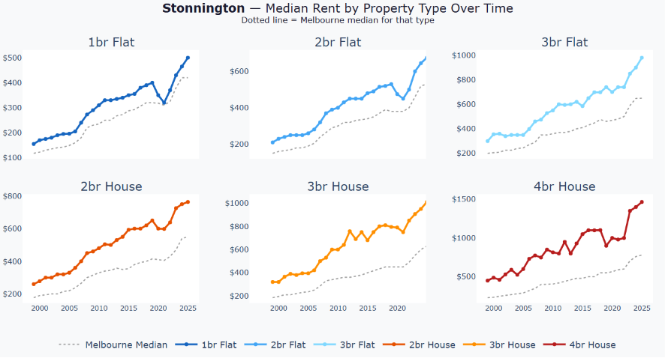
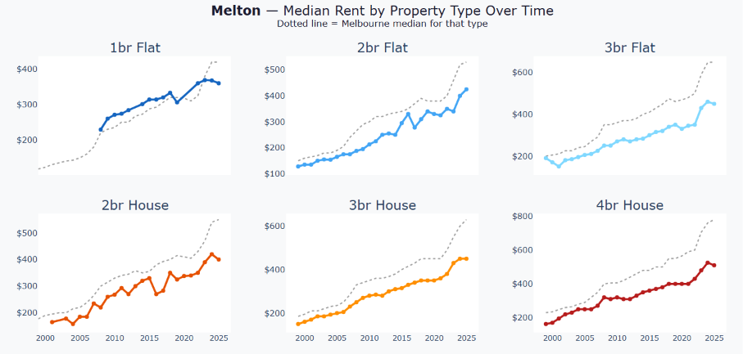
LGA Comparison and Property Type Breakdown
Stonnington
Melton
Inner East — always expensive
Outer West — rapidly rising
VS
Highest absolute rents throughout the period. Relatively moderate % growth — the ceiling was hit early. A benchmark of sustained premium demand.
Once one of Melbourne's most affordable LGAs. Greenfield expansion and population growth have driven the highest % rent increase of almost any LGA over 25 years.

Slide 13



What the Rental Data Tells Us
Affordability Has Fled Outward
COVID Rewrote the Rules — Briefly
What was cheap is no longer cheap. The rental map of Melbourne looks fundamentally different today than in 2000.
A genuine rent deflation in 2020–21 — rare in Australian history — followed by one of the steepest rebounds on record.
Property Type Matters
Outer Suburbs Closing the Gap
Flats and houses tell different stories within the same suburb. Flat rents lagged; house rents led the rebound.
The cost gradient between inner and outer Melbourne has narrowed — but income and transport access have not kept pace.

Slide 14
Questions and Discussion

